Slide 1

“Waste Warp”
-Team 6
[Fig 1]
University of Texas at Arlington
CSE 3330
Bhanu Jain
TA’s: Tariq Alsahfi,
Spardha Gupta
Done By:
Nihar Gupte
Pranav Bhandari
Ruta Vaghasia
Imtiaz Khaled
Rhea Pottathuparambil

Slide 2
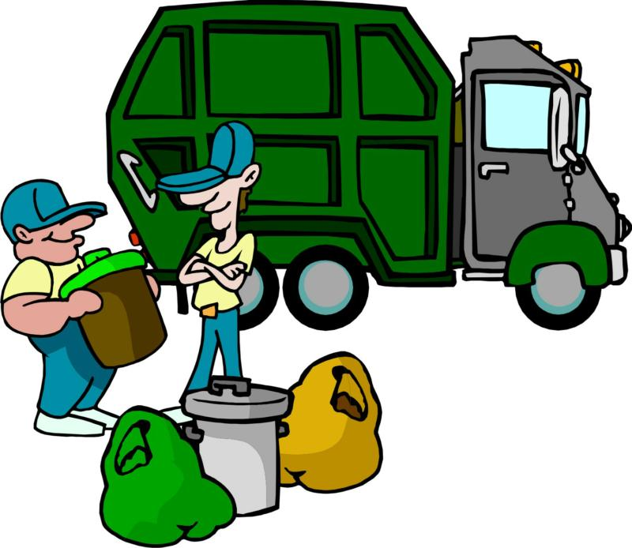

What do we do?
[Fig 2]
We focus on picking up waste for free from user’s requested location using our web interface.
We sell the recyclable waste to corporations that make products from waste, organic waste to anaerobic digesters and solid waste to waste incinerator companies (waste-to-energy plants).
We get help in collecting waste from many universities’ volunteer organisations.
We mainly operate in the United States but open to opportunities for expanding in other countries

Slide 3
Competitors
Our competitors are various trash clean-up organizations like:
Waste Management Inc. [https://www.wm.com/us/en/myhome]
Republic Services Inc. [https://www.republicservices.com]
Stericycle Inc. [https://www.republicservices.com/]
Competitors | Our company
Scheduled trash pickup Dumpster rental Manufacturing and Industrial waste | Easy to use (Web Interface) Free of cost Waste management awareness programs

Slide 4
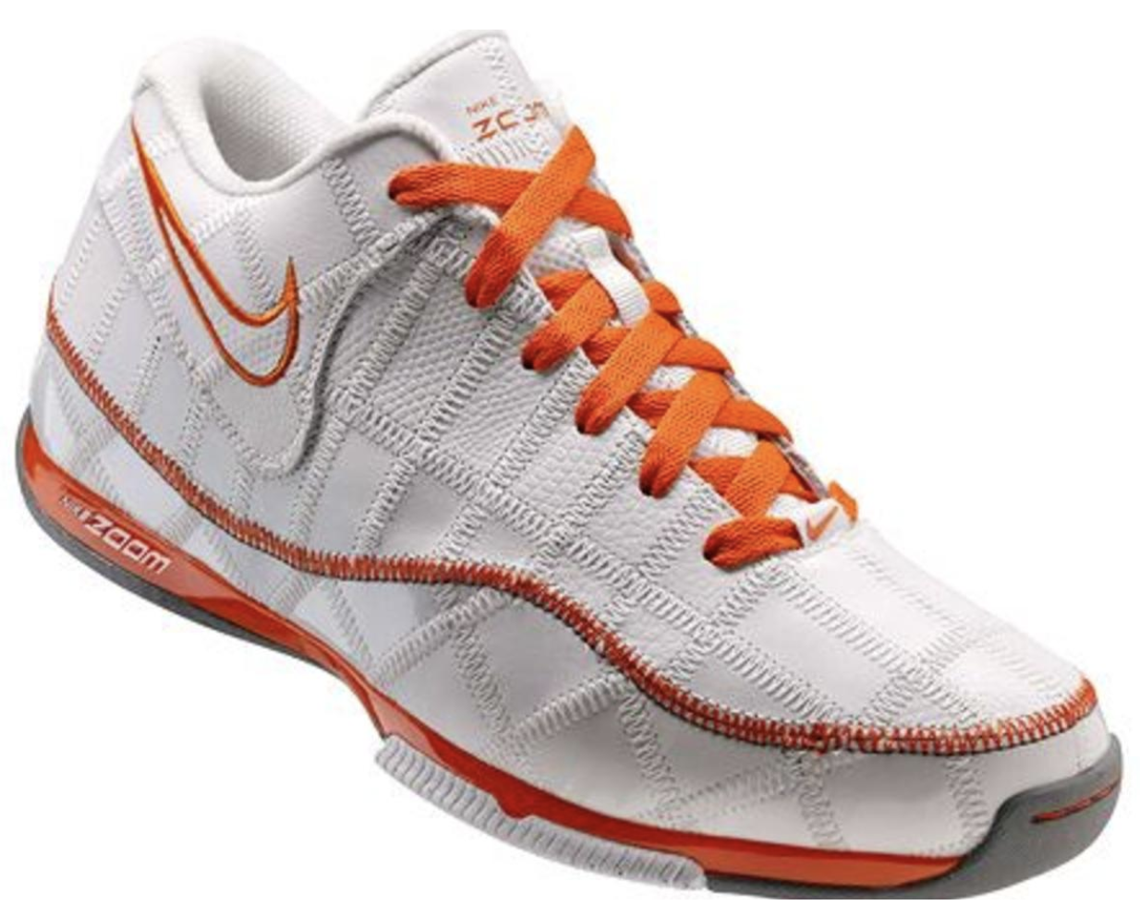
Collaborators
We collaborate with many universities’ volunteer organisations that aids in picking up trash from requested locations.
We also work with the Parks and Recreation Department of many cities across the United States and organize the trash cleanup for smoother sailing.
In the end, we sell collected trash to companies like Nike and Adidas which make shoes from waste that you’re wearing right now!
“Nike Trash Talk”

Slide 5
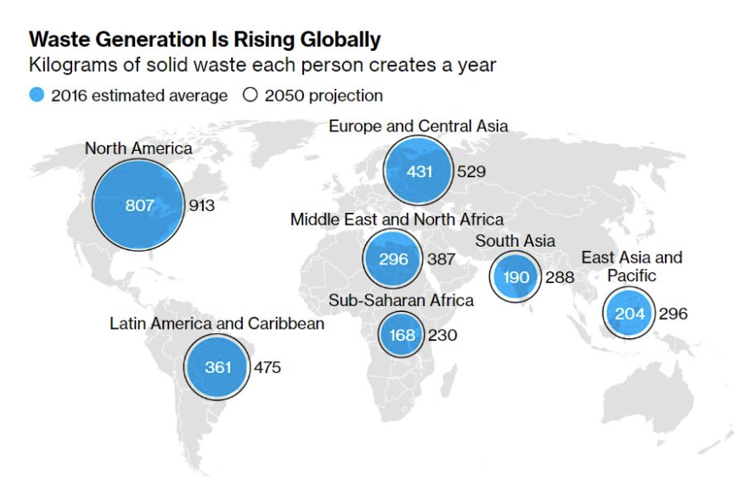
Why waste warp?
United States is in the lead of generating waste, seven pounds of trash per american everyday- that’s 255 million tons every year!
We are all accustomed to the phrase “take only photographs, leave only footprints." Well we have expanded the “Leave No Trace” concept, to “take only photographs and 10 pieces of litter, and leave only footprints.”
[Fig 3]
Notes:
Our planet’s future, Leading by example, Safety, Inspiring others

Slide 6

Services offered by Us
[Fig 4]
We have a web interface which lets our users report trash, and when the trash reaches a certain amount, We contact nearby universities organisations and students help us out in cleaning up trash. For industrial waste, we send our garbage trucks to collect the waste.
After collecting the trash using local services from various universities and cities’ Parks and Recreations services, we segregate the trash as per the needs of various companies.

Slide 7

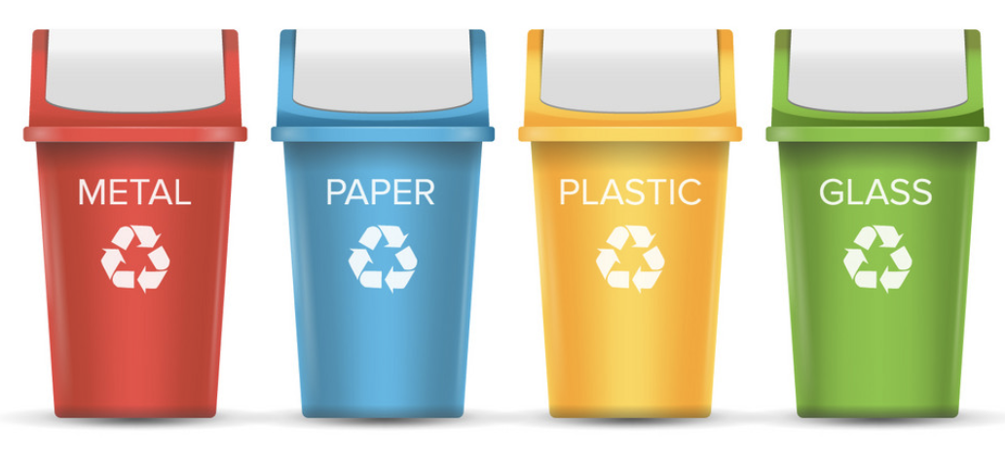
Other areas where our company has a positive impact
We make numerous efforts in protecting the environment, nature and health of the population and make the world better place to live. Arrange waste awareness programs in schools, universities and local communities Provide e-tutorials and trainings on collecting and segregating waste Planning on selling different types of recycle bins at low cost
[Fig 5]

Slide 8
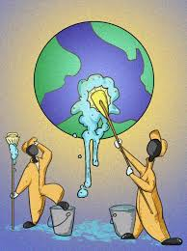
Impact on World Trash
Since our company started in 2016, we have successfully increased overall environmental consciousness by 15%.
Our recycling and trash cleanup programs have successfully kept a huge volume of trash out of landfills.
Recent data shows that the total trash
produced by U.S has reduced by 3% in the past
two years. We know that there might be other
factors to this too, but we can’t help take
some credit.

Slide 9
Requirements for Database
Our Mini World
The Database shall keep track of the Users using the web interface to report Trash and the amount of trash sold to various clients.
A USER has a unique username, a name consisting of FName and Lname, Password, email, and phone_no.
A LOCATION has an address.
COLLECTED_TRASH has a unique TrashId, weight and collected location.
An ENERGY_PLANT has a unique EId, address, name, phoneNo
A USER can be a CUSTOMER who has company_name, or can be a COLLECTOR who has points.

Slide 10
Requirements continued
A COLLECTOR can either be a VOLUNTEER who has an organization or a STUDENT who has a uni_name.
The COLLECTED_TRASH can be either RECYCLABLE which has a type or NON_RECYCLABLE.
A USER reports trash at a LOCATION.
A USER supervises a LOCATION.
A CUSTOMER buys RECYCLABLE Trash.
A COLLECTOR collects COLLECTED_TRASH
COLLECTED_TRASH is picked up from a LOCATION
NON_RECYCLABLE trash is sold to an ENERGY_PLANT and the amount of trash sold is recorded.

Slide 11
Defined Entities and Attributes
USER - Strong entity with key attribute username, and other attributes FName, LName, Email, Password, PhoneNo
LOCATION - Weak Entity with partial key Address, dependent on the identifying relationship Report_trash, with primary key username.
CUSTOMER - Specialized class of USER with attribute Company_name
COLLECTOR - Specialized class of USER with attribute Points
VOLUNTEER - Specialized class of COLLECTOR with attribute organization.
STUDENT - Specialized class of COLLECTOR with attribute uni_name.
COLLECTED_TRASH - Strong entity with key attribute TrashID, and other attributed Weight and Collected_location.
RECYCLABLE - Specialized class of COLLECTED_TRASH with attribute type.
NON_RECYCLABLE - Specialized class of COLLECTED_TRASH
ENERGY_PLANT - Strong entity with key attribute EID, Name, Address and PhoneNo.

Slide 12
Defined Relationships
Relationship Name (R) | Identifying Relationship? | Entity 1 Involved (E1) | Entity 2 Involved (E2) | Cardinality Ratio between E1 and E2 | Participation of E1 in R | Participation of E2 in R | Attributes
Report_trash | Yes | USER | LOCATION | M:N | Partial | Total | nil
supervise | No | USER | LOCATION | 1:1 | Partial | Total | Nil
buy | No | CUSTOMER | RECYCLABLE | M:N | Partial | Partial | Nil

Slide 13
Defined Relationships continued
Relationship Name (R) | Identifying Relationship? | Entity 1 Involved (E1) | Entity 2 Involved (E2) | Cardinality Ratio between E1 and E2 | Participation of E1 in R | Participation of E2 in R | Attributes
pick_up | No | LOCATION | COLLECTED_TRASH | M:N | Partial | Partial | nil
collect | No | COLLECTOR | COLLECTED_TRASH | M:N | Partial | Total | Nil
sell | No | NON_RECYLABLE | ENERGY_PLANT | 1:N | Partial | Total | weight

Slide 14
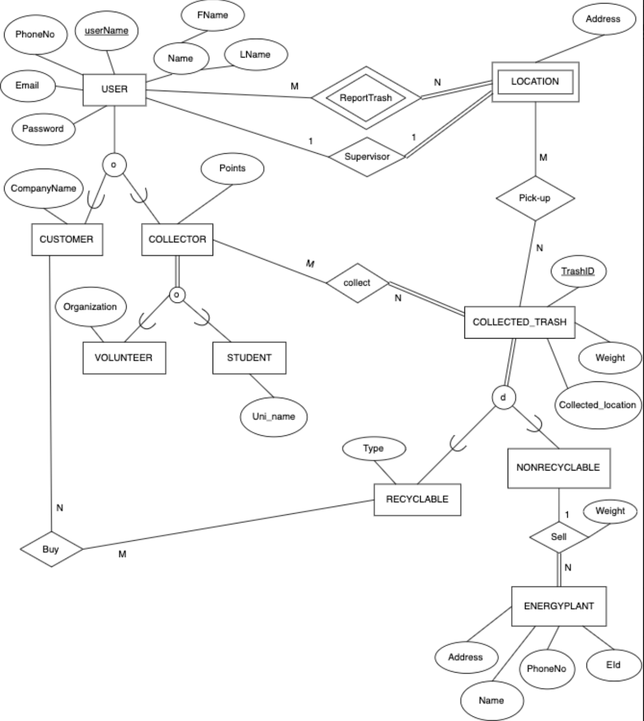
ER/ EER Diagram

Slide 15
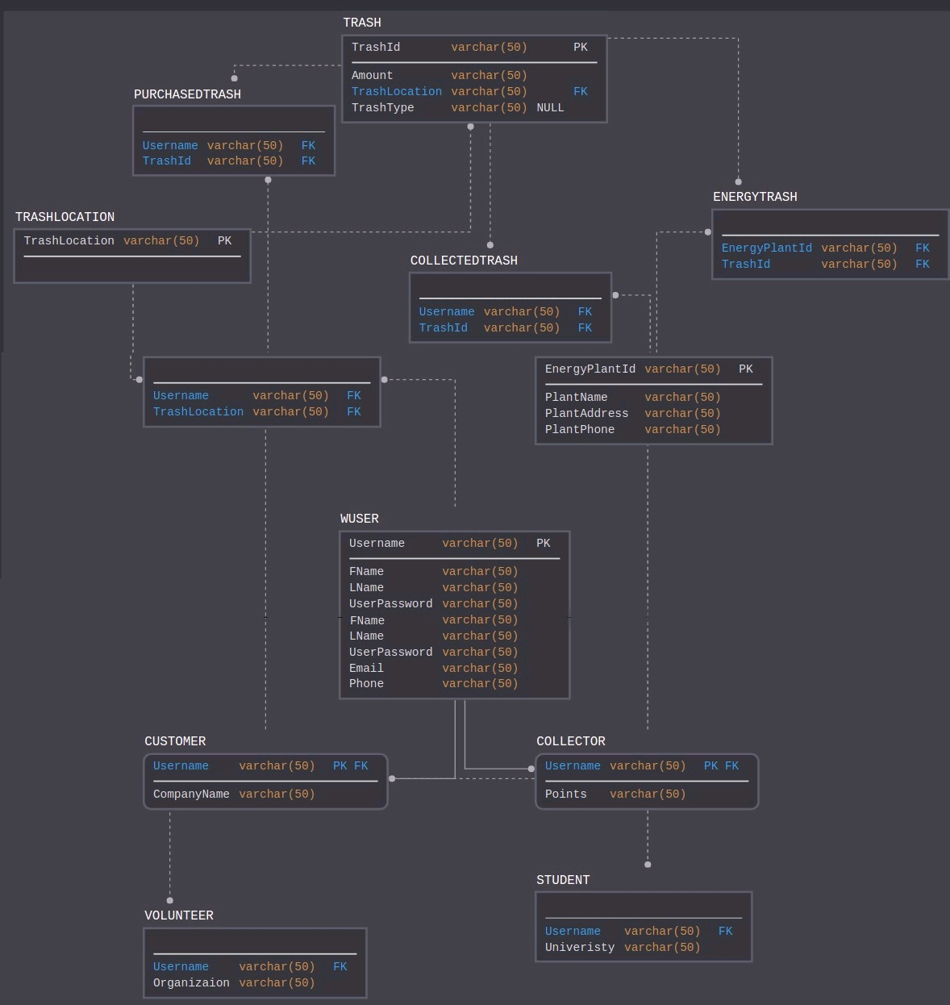
Relational Schema

Slide 16
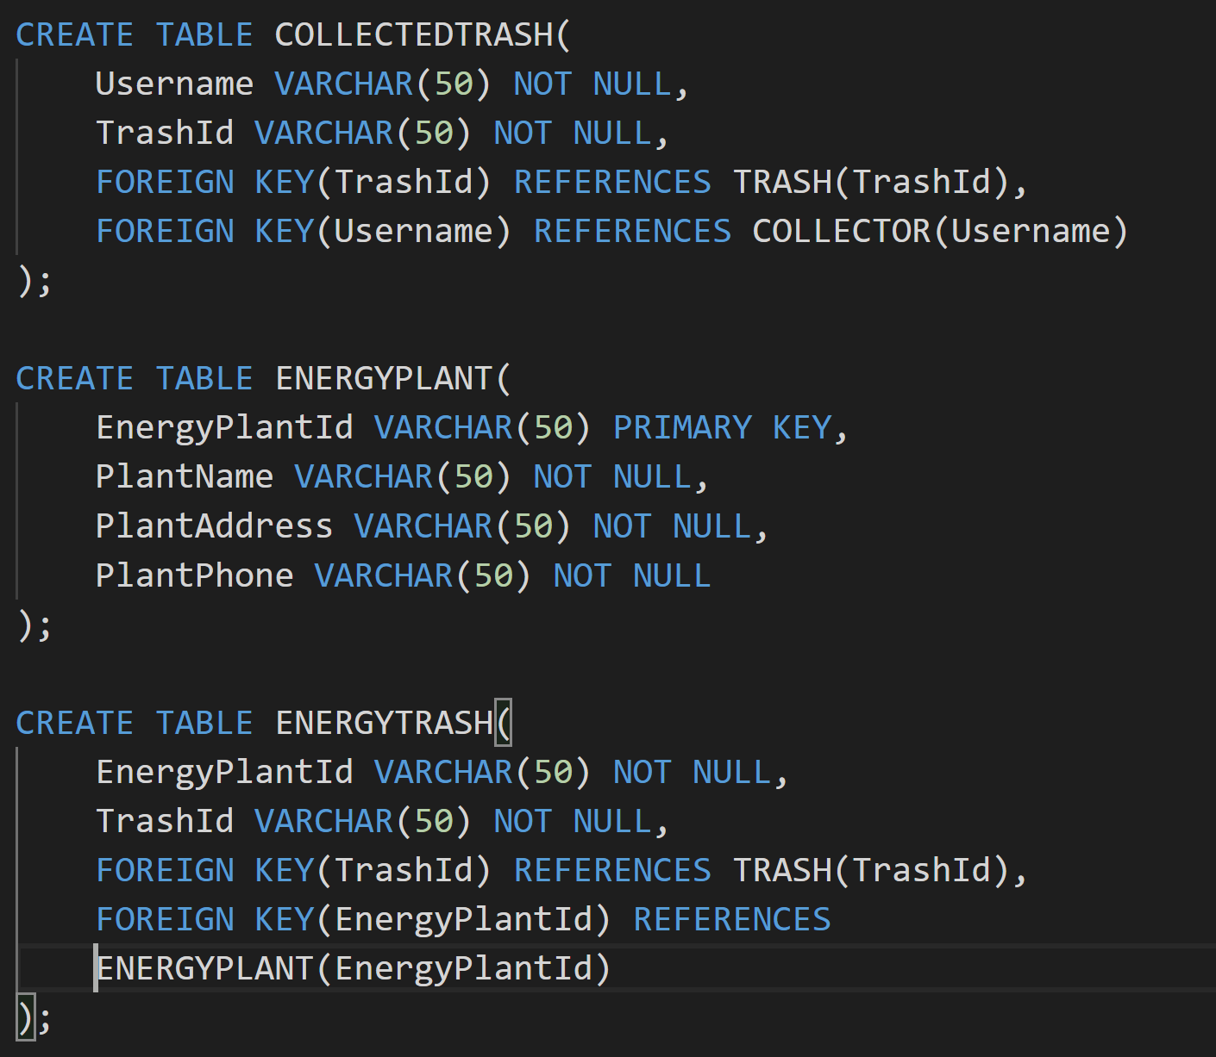
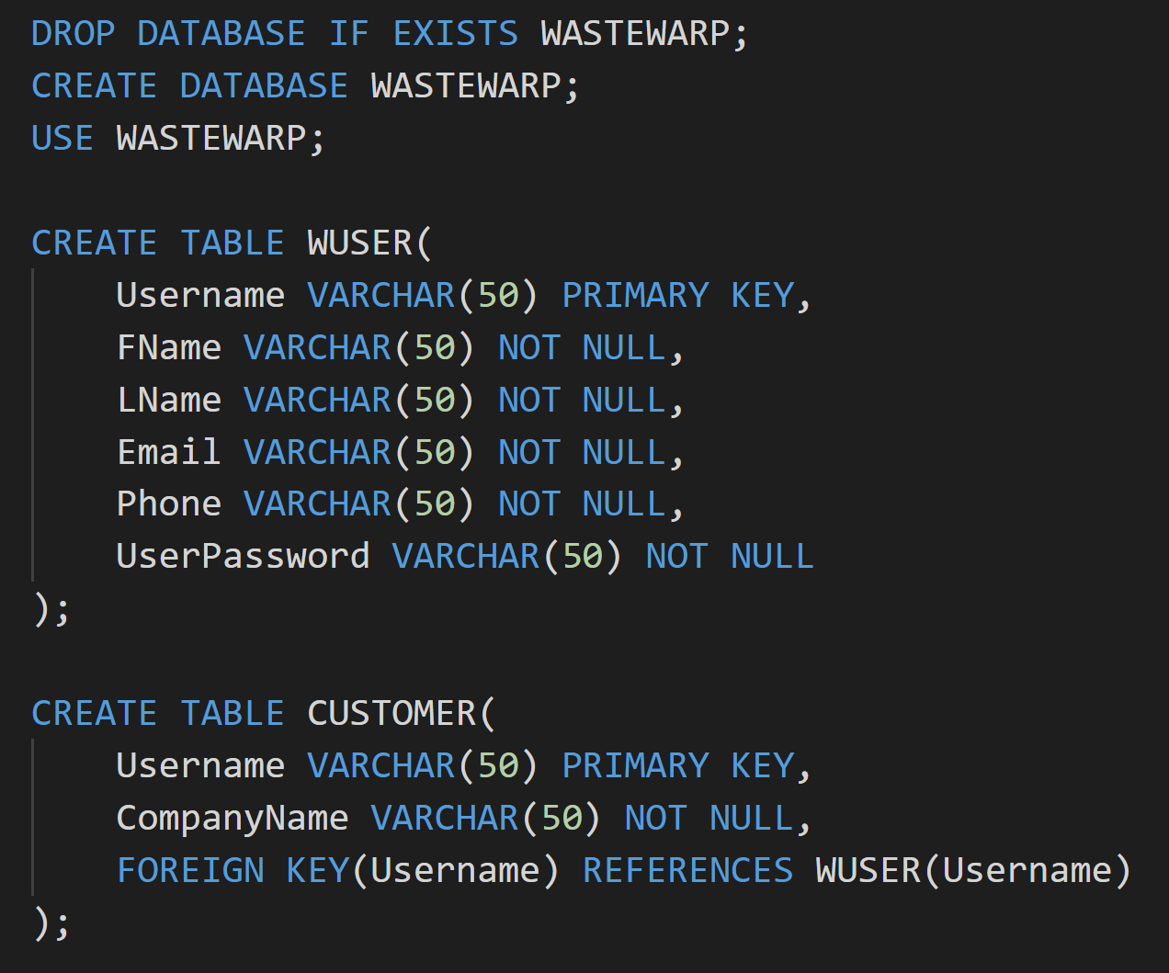
Database Creation - Scripts

Slide 17
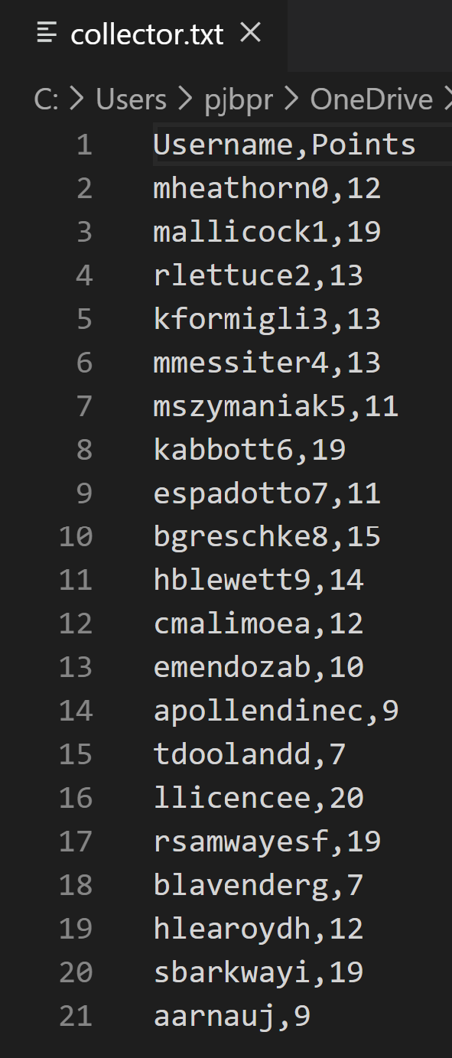
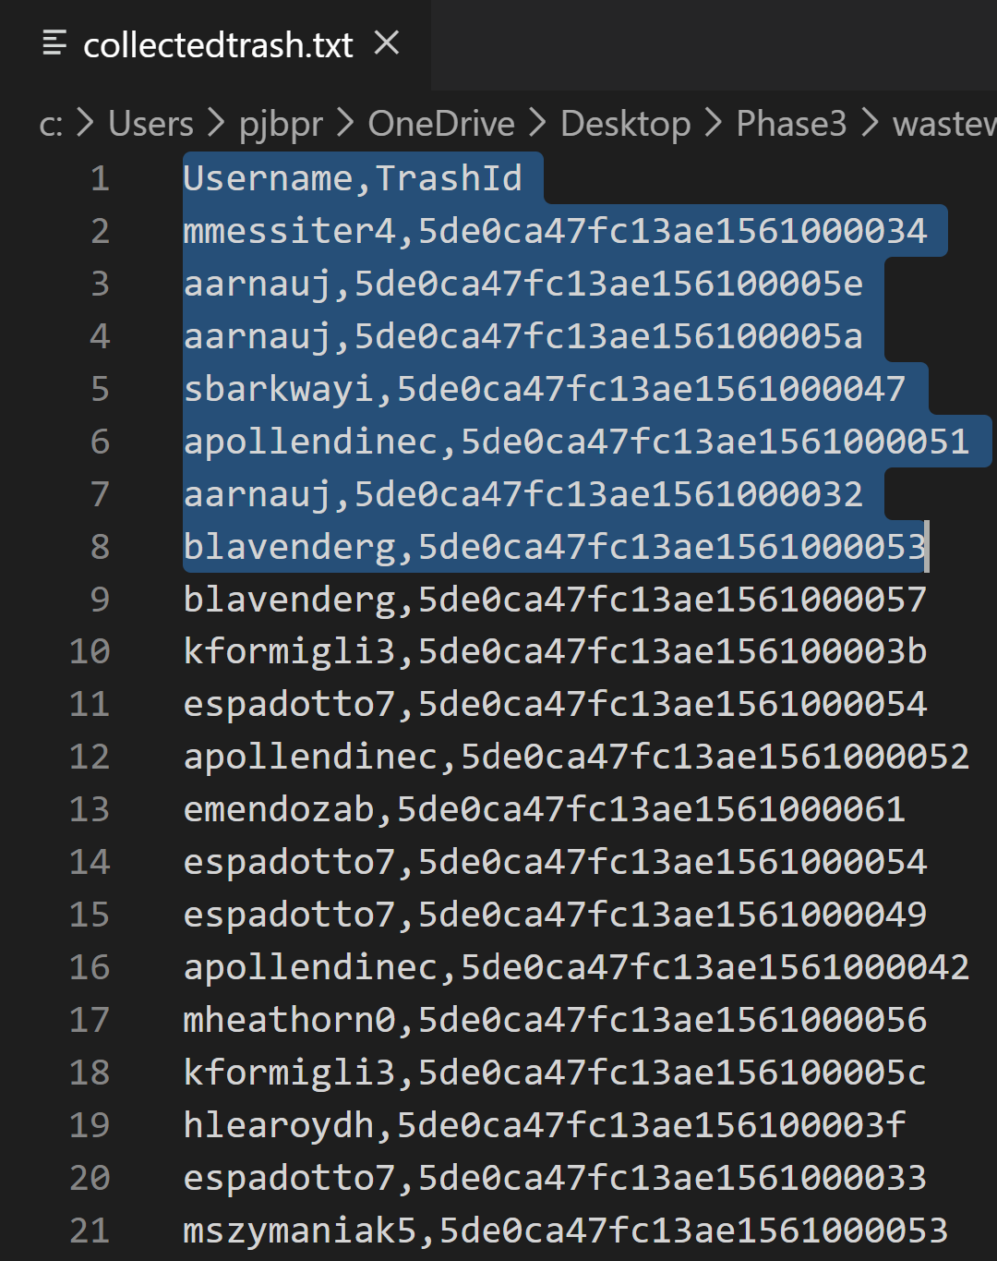
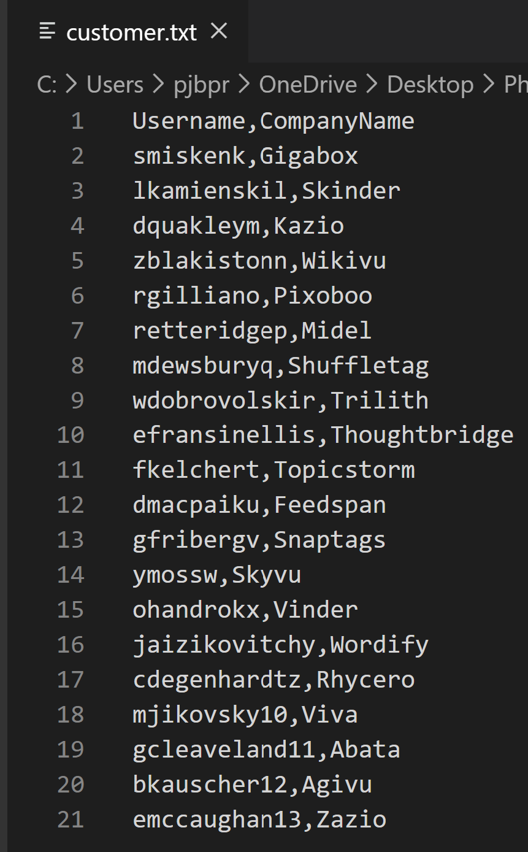
Data files with realistic data

Slide 18
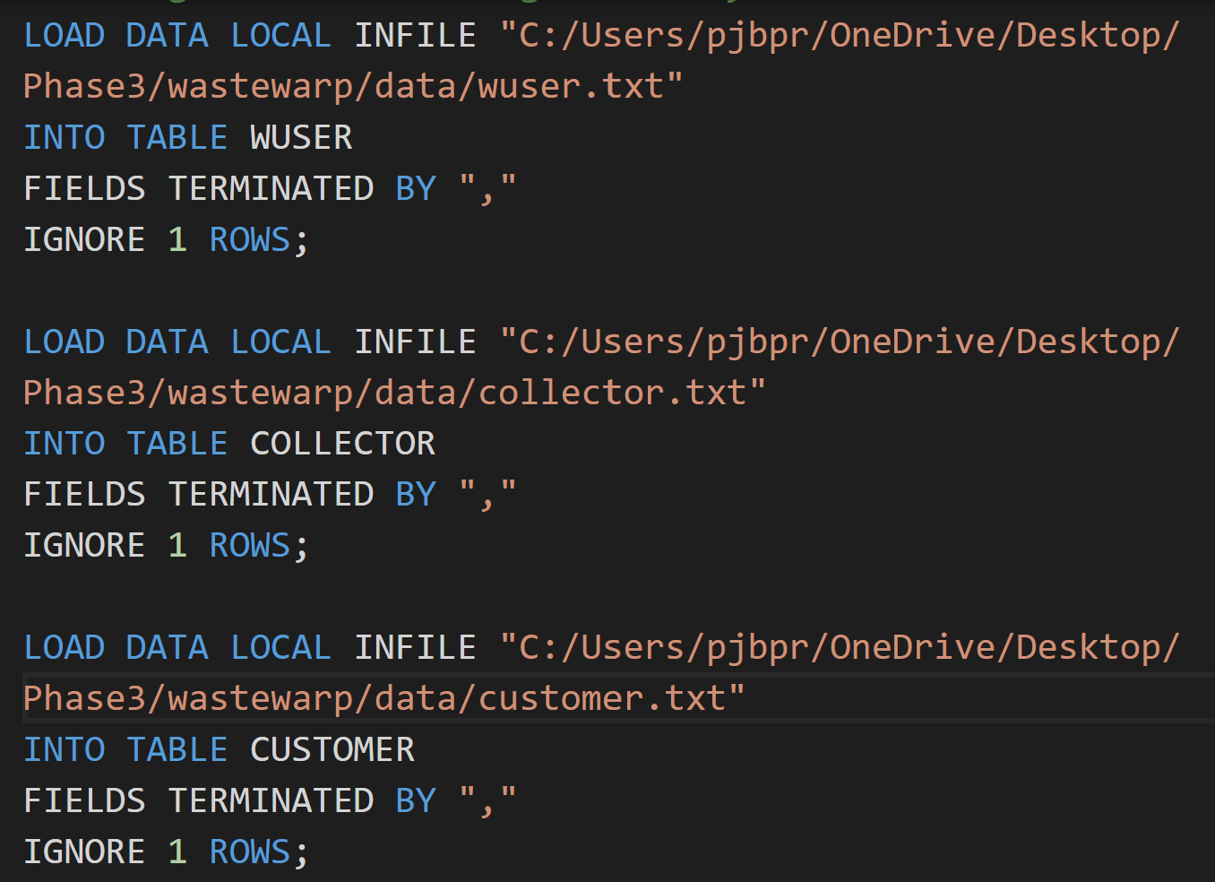
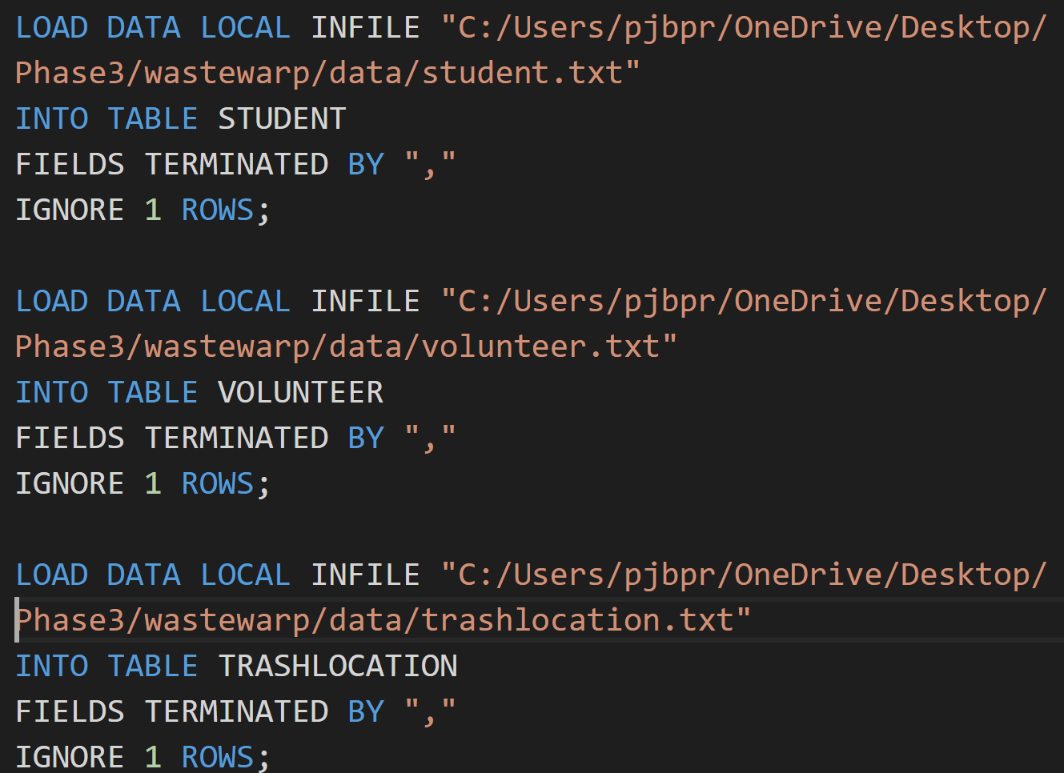
Scripts to populate the database

Slide 19
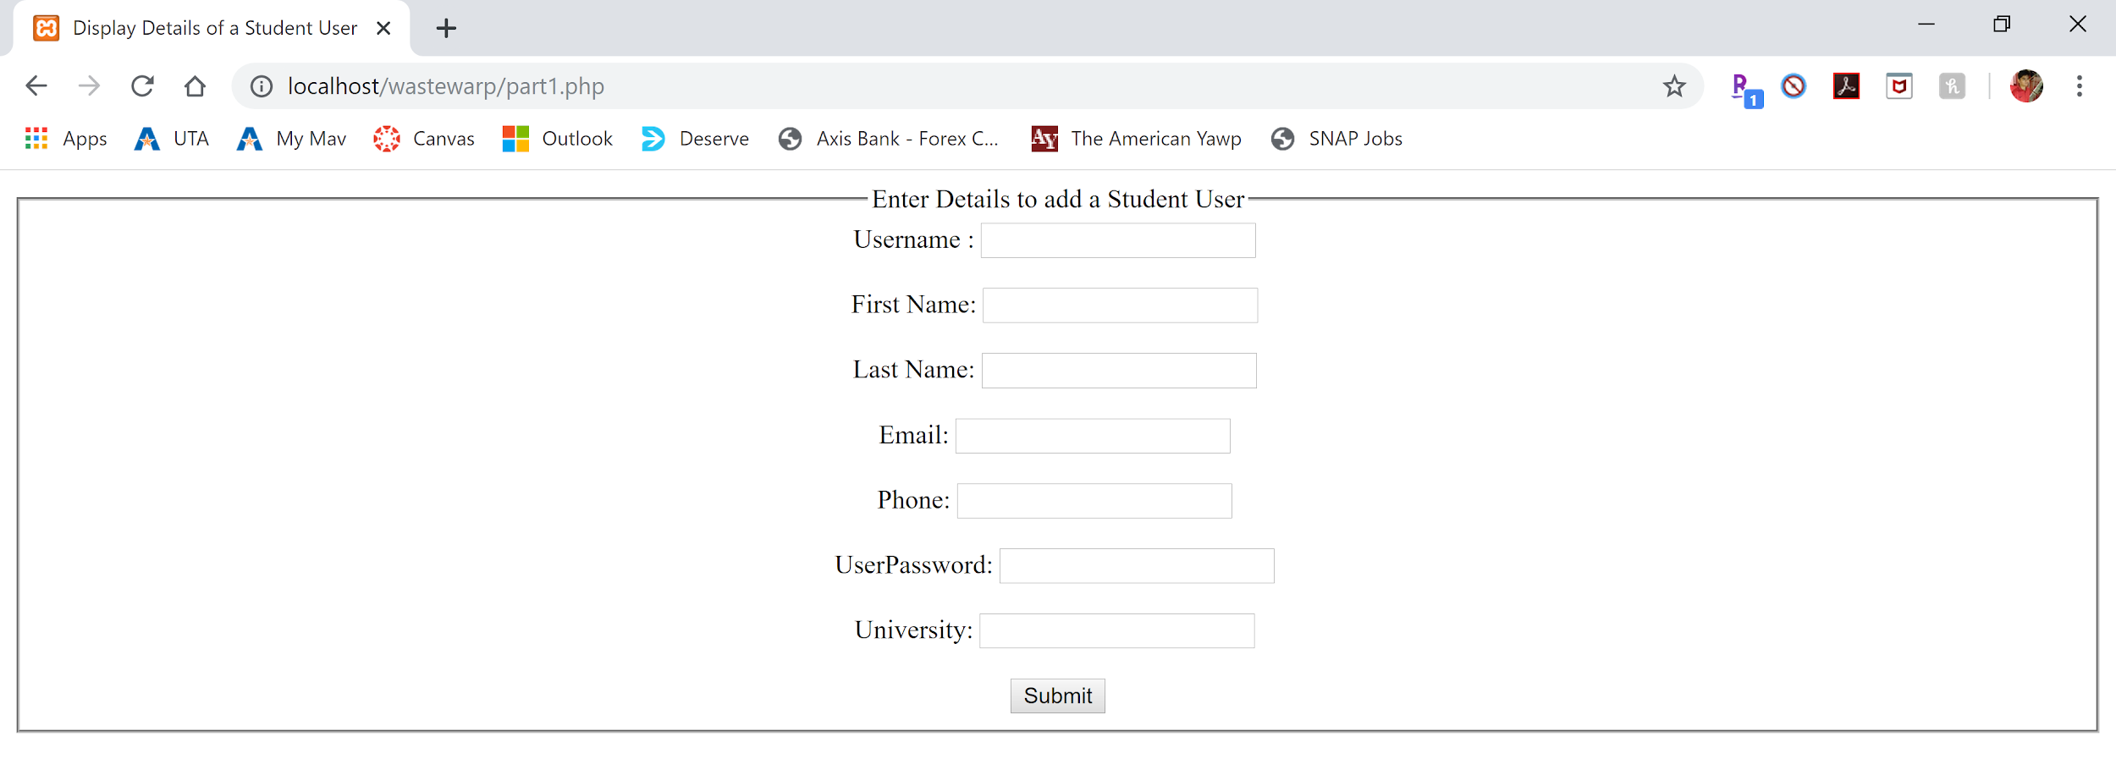
Web interface visuals

Slide 20
How this fulfills our business requirements
The Database keeps track of all existing customers, collectors and trash.
The trash is picked up by collectors, and the trash is then added to the database, along with its type.
The trash is then matched with collectors who are looking for that specific type of trash.

Slide 21
Influence of this research on our lifestyle
There was a lot of work put into this project, from the start till the end. This required a lot of research about our domain.
This project has made us realize the reality of World’s pollution problem. We have realized how much work is needed to clean trash, which we as individuals can clean ourselves. This realization has made us aware and we have taken steps in our day to day lives to reduce the amount of trash.

Slide 22
References
[Fig 1]: http://www.smythcounty.org/solid_waste/solid_waste.htm
[Fig 2]:http://www.butmantwp.com/quick_links/household_hazardous_waste.php:
[Fig 3]: https://www.businessliveme.com/environment/worlds-2-billion-ton-trash-problem-just-got-more-alarming/
[Fig 4]: https://www.factset.com/services
[Fig 5]: https://www.theatlantic.com/magazine/archive/2015/07/future-of-trash/395279/
[Fig 6]: https://www.vectorstock.com/royalty-free-vector/colorful-recycle-trash-bins-set-of-vector-16347077
https://www.euronews.com/2018/04/20/what-plastic-objects-cause-the-most-waste-in-the-sea-
https://www.energydigital.com/top-10/top-10-us-waste-management-companies
https://www.plasticpollutioncoalition.org/blog/2016/8/19/10-reasons-to-pick-up-10-pieces-of-trash
https://www.norcalcompactors.net/recycling-positive-effect/

